Slide 1
Government Programs – ML & Data Science Team

Slide 2




Mission and Purpose
Build predictive models, discover patterns and generate actionable insights by leveraging machine learning & data science for Government Programs strategies to provide people with a choice of innovative health and well-being solutions.
GP Leadership
Business owners
Application owners
Strategic Insights
Predictive Models
Data to Insights
GP Data science team
Domain expertise
Application knowledge
Data science skills
GraphDB
Data lake
HCP
Member admin
Claims
Appeals

Slide 3
Significant ML Use cases

Slide 4
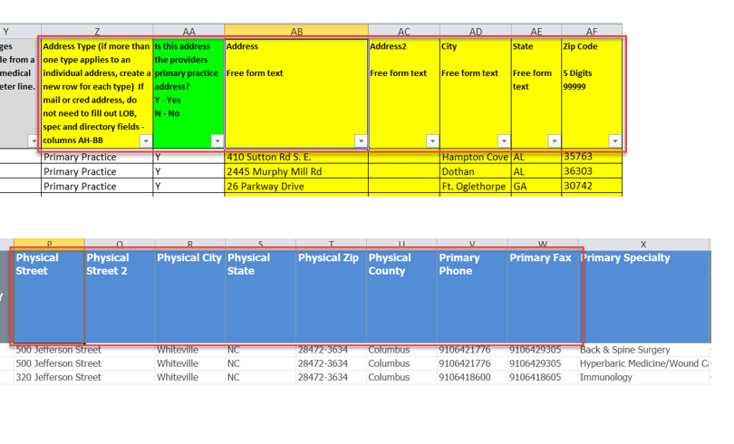
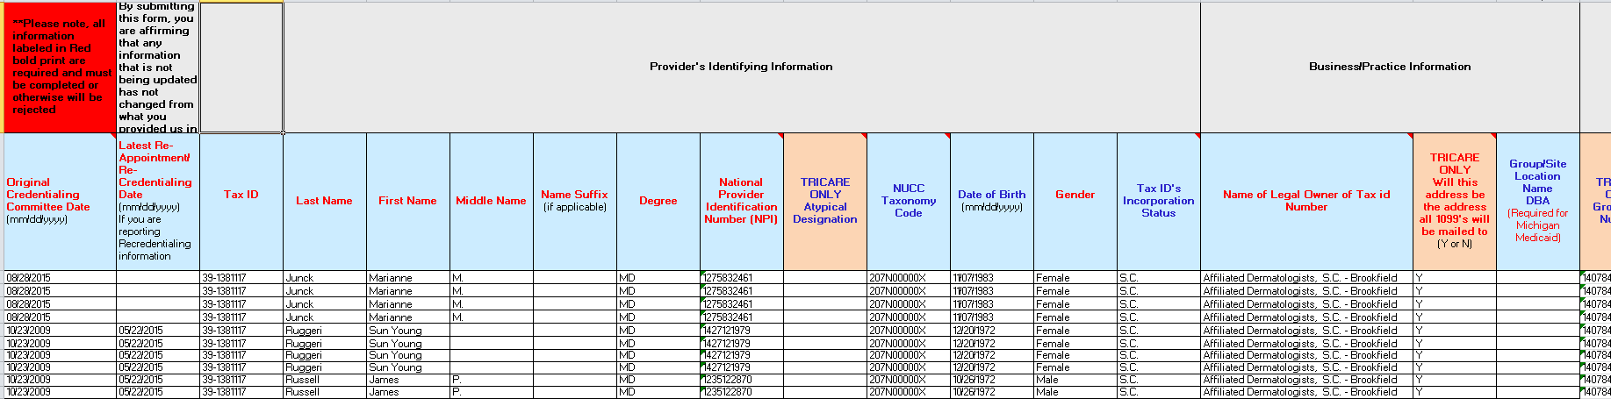
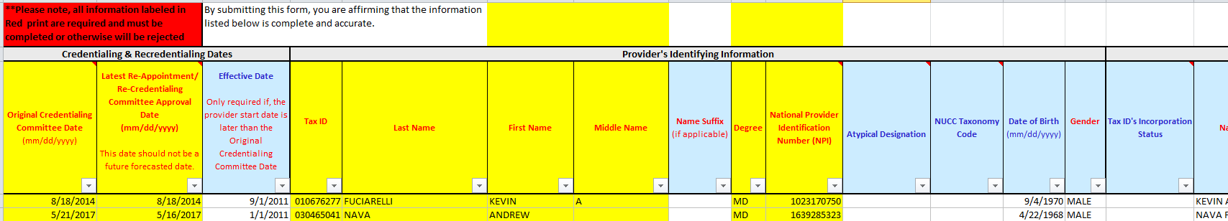
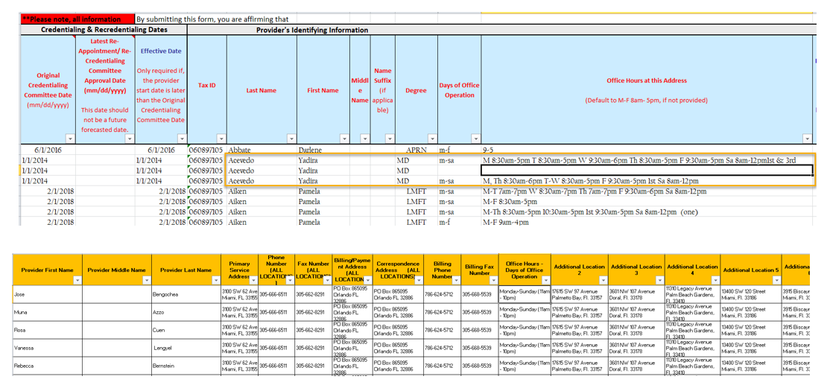
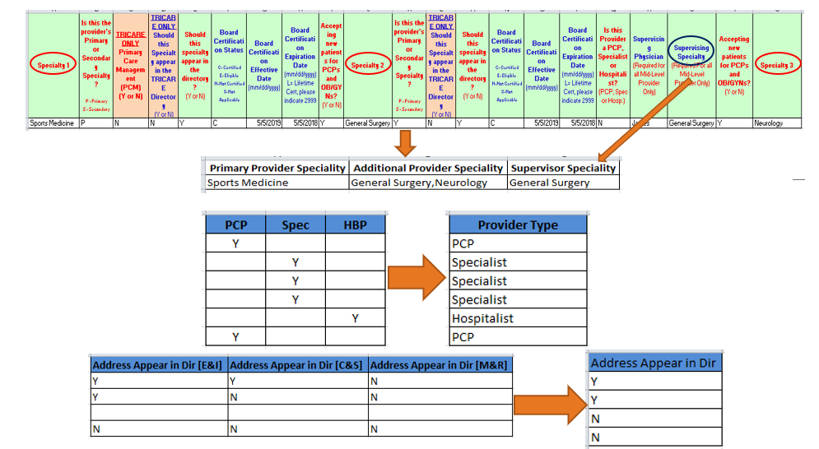
Provider roster standardization
Problem statement
Provider groups submit add, change & term rosters in a nonstandard format
~200+ FTEs manual work is involved in analyzing & standardizing 100+ columns
Industry estimates indicate that $2.1 billion is spent annually across the healthcare system acquiring and maintaining provider data.
Patent filed – June 2021
US Appl. 17/344,489
US Appl. 17/350,285
1
Inconsistent column headers
2
Merged vs. split column headers
3
Extracted vs. inferred values
4
Rows vs. column data representation

Slide 5








Solution overview
2
3
Nonstandard Roster
Analyze each column and predict the column name based on classification approach – Random Forest Classifier
Analyze the output of the 4 models and confirm the final column name for prediction
1
Sample the values in each column and predict the data type such as date, city, specialty etc.., -– Random Forest Classifier
4
Apply clustering logic to group the applicable individual columns into one functional group column. Ex: Board Name, Certificate & Credential date are clustered into Board Cluster – K Means
Analyze data in each column along with its column header for known pattern and predict the column name - NLP
Non standard Roster 1
Non standard Roster 2
Use rules based approach to find column names, these rules are applied for small set of columns, typically for managing rare scenarios
5
Check the list of missed columns against past rosters columns of interest inventory and identify missed columns
Non standard Roster 3
Non standard Roster 4
Non standard Roster 5

Slide 6
Solution outcome
Outcome achieved
Mandatory column accuracy – Above 90%; Overall accuracy - 80 %
Deployed in production
Patent application in progress
Reusability
Highly reusable for provider data standardization & customizable for other scenarios
Key technical aspects
Random Forest Classifier, K-Means

Slide 7
Medicare Claims appeal prediction
Problem statement
Historical analysis¹ shows in a year ~127 million claims are processed & ~280K provider appeals are received
Industry analysis & internal metrics show it cost ~$118 to process an appeal
Can we predict potential of a Claim partially or fully denied claim resulting in an appeal? – Improve provider experience & reduce cost
PEND for DEV
Let Gen
Claim approved
Outcome?
Claim submitted
First pass processing
Claim partially approved
Dispute
Rework team
Claim denied
Appeal
Clinical MD Review
Recon request
MCR MD Review

Slide 8



Solution overview
Grouped Claims
Model for a Group
Grouped Claims
Model for a Group
EDA
Candidate Claims
Reason Code
grouping
Claims
Grouped Claims
Model for a Group
Provider Type | Payment CD | # Claims | # Appeals | % Claim | % Appeal
Par Provider | FFS | 32,659,991 | 30,044 | 25% | 11%
 | CAP | 62,617,633 | 50,212 | 49% | 18%
Non Par Provider | FFS | 14,389,647 | 68,644 | 11% | 24%
 | CAP | 17,760,169 | 130,090 | 14% | 47%
Contracted pay as Par | FFS | 2,616 | 2 | 0% | 0%
 | CAP | 2,843 | 11 | 0% | 0%
Contracted pay as Non Par | FFS | 264 | 2 | 0% | 0%
 | CAP | 589 | 3 | 0% | 0%

Slide 9
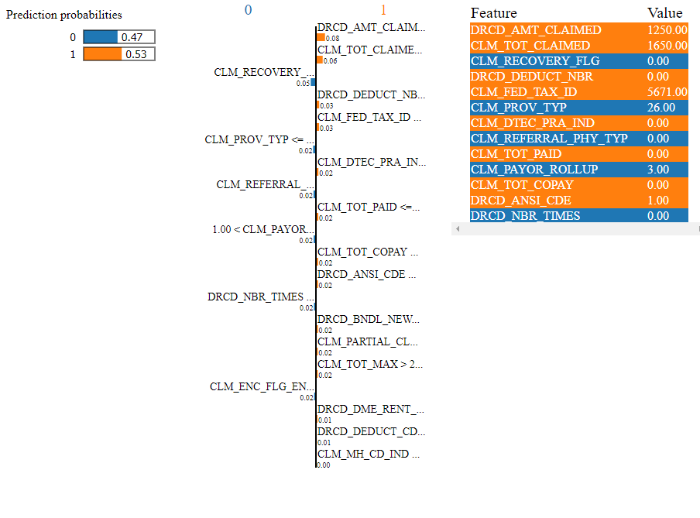

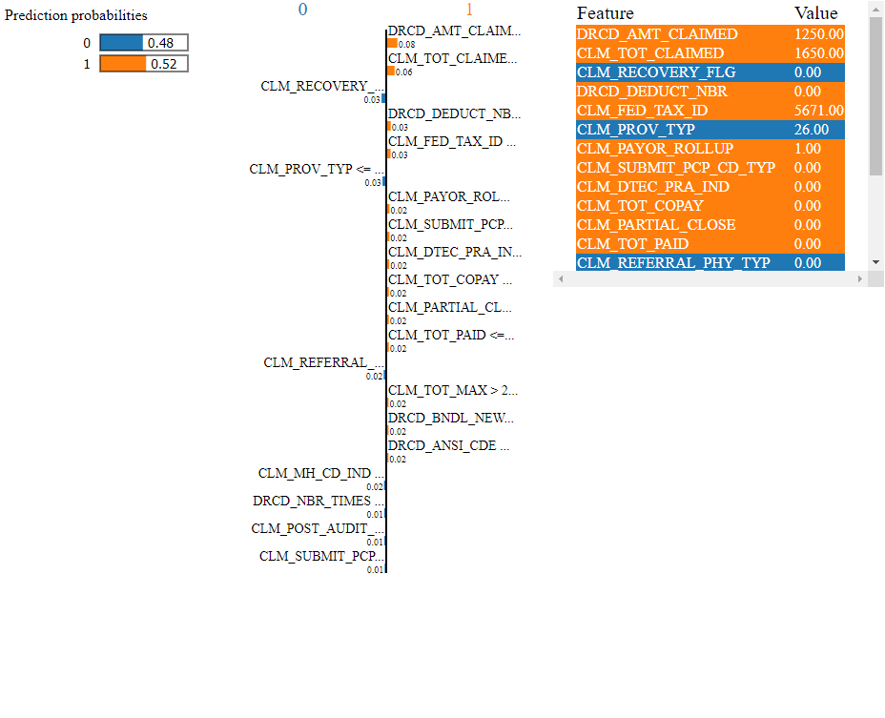

Solution overview
Denied claim
Denial reason?
Appeal prediction models
Explain the outcome
Predicted claims

Slide 10
Prediction accuracy results
The POC has been tuned in favor of
ensuring high probability that a predicted claim will go for an appeal
review and improve claims missed to be predicted without reducing accuracy
Rational – Effective utilization of the analyst time to avoid a predicted claim to be appealed; Model to be inclemently tuned to predict more claims without impacting accuracy

Slide 11

MVP Validation approach
Claim partially / fully denied
Appeal?
Assign to analyst for review
Yes
Claims appeal prediction
model
Potential avoid?
No
Yes
Document reason & close
Assign to analyst for review
Take action
Document action
Document savings
Document reason & close
Possible to adjust process for future
Propose action
Potential savings
No
Yes
Monthly savings project published

Slide 12





Appeals case digitization
Problem statement
M&R and C&S appeals team spend manual effort digitizing case details as part of case setup process
~3.5M is spent yearly for this manual effort
The case setup is governed by CMS guidelines and has direct impact to STAR rating hence a critical process
Triage
Scrub
Route
Validate
Route
Close
RMO
Case setup team
Case processing team
DDE
ATS
MACESS
ETS

Slide 13






Solution overview
Training documents
TF-IDF
SME validated & refined key words & weights
XGBoost model
Classification module – one each for – Pre service, Post service & submitted on behalf of
SME provided keywords
Template detection Kmeans model
Context detection RNN Model
Priority identification module
Compute confidence score
OCR / ICR
DDE/ ETS/ MACESS
RMO
Training documents
TF-IDF
SVC Classifier Part C vs. D
GBC Classifier Part C variations
Reinforcement module
Source systems
Benefit type identification module
Training documents
TF-IDF
Issue type - Ngram classification
Issue category - Gensim - LSI model
Issue type & category identification module

Slide 14
Solution outcome
M&R
0.5M M&R appeal cases a year is being processed by this system - 45% of M&R volume
$0.54M a year savings is already realized by M&R appeals team
The next phase of the solution expected increase the coverage to 75%
The ML module is integrated with DDE
C&S
Launched in production 4 weeks ago integrating with MACESS & ETS – Processed 27K cases
8K cases are fully processed and case setup completed in ETS
16K cases are identified for special processes and automatically routed
This solution is expected to ~0.9M/year

Slide 15
And many more ….
Thank you!

Slide 16
Solution overview
SME provided keywords
Template detection Kmeans model
Context detection RNN Model
Priority identification module
Compute confidence score
OCR / ICR
DDE
RMO
Training documents
TF-IDF
SVC Classifier Part C vs. D
GBC Classifier Part C variations
Reinforcement module
Source systems
Benefit type identification module

